Slide 1
Intro to Set Theory
The Math of Santa’s Bag

Slide 2
But first...

Slide 8
Now back to our regularly scheduled programming...

Slide 9
What is a set? (from Wikipedia)
Definition: A set is a well-defined collection of distinct objects. The objects that make up a set (also known as the elements or members of a set) can be anything: numbers, people, letter of the alphabet, other sets, and so on.
One of the founders of set theory Georg Cantor, gave the following definition:
“A set is a gathering into a whole of definite, distinct objects of our perception or of our thought-which are called elements of the set.”

Slide 10
But really… what is a set?
A set is a magic bag that can contain anything or nothing...

Slide 11
Familiar examples of sets
Natural numbers (counting numbers)
Integers (counting numbers and negatives)
Rationals (fractions)
Real numbers (fractions plus weird ones like pi etc.)

Slide 12
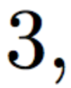
Writing a set:
First, we can list the elements:
Write these to mean it’s
a set

Slide 13
Writing a set: (no repetition)
We don’t stutter when we write a set!

Slide 14
Writing a set: (ORDER IS NOT IMPORTANT)

Slide 15
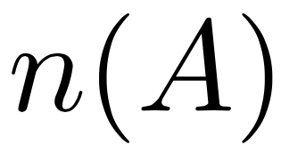
Cardinality:
We denote the number of elements of a set as

Slide 16
Example
3

Slide 17
Another Example:
Special set: The Empty Set
Look its empty!

Slide 18
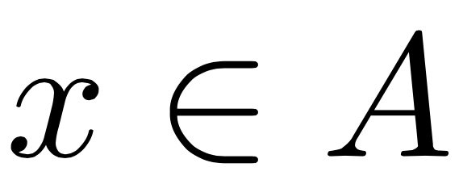
Notation for sets:
We will use capital letters to indicate sets
Like:
We also have a symbol for membership that is when x is an element of a set A we write:

Slide 19
Fun example:
Pizza is in this set so we write: and say “pizza is in A”

Slide 20
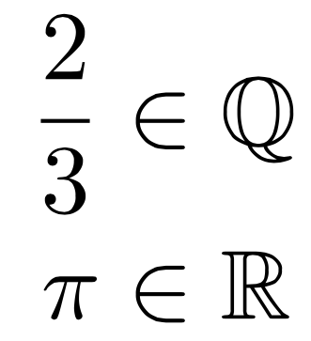
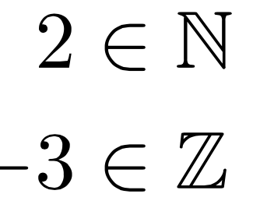
In our Familiar Examples:

Slide 21
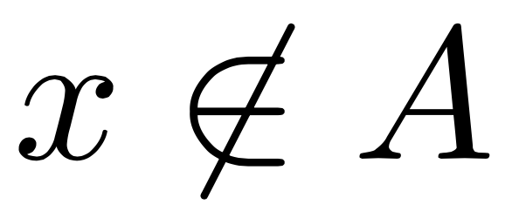
Notation for “not-in”
We also have notation for not being a member of the set:

Slide 22
Fun example:
Bob is not in this set so we write: and say “Bob is not in A”

Slide 23
Logic is back in the game!
Membership of a set is a “statement” that is it has a truth value:
This statement is true/false!

Slide 24
Subsets
Definition: A subset is made of only the elements of another set.
If A is a subset of B we write:

Slide 25
Subsets (logic definition)
Definition:
is true whenever the following statement is true for every x in A:

Slide 26
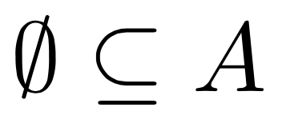
Weird conclusions...
The empty set is a subset of any set:

Slide 27
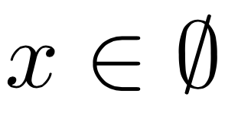
WTF?
Well is this statement true?
This statement is FALSE!!
There is nothing in the empty set!!

Slide 28
Universe (of discourse)
We at times discuss the subsets of a given “larger set” this set is referred as The Universe of discourse, If this set doesn’t already have a name we usually denote it as:

Slide 29
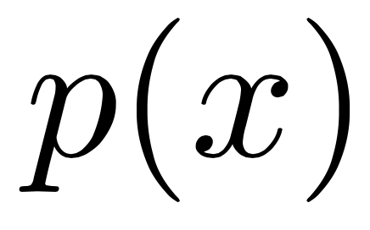
Writing a set: “set builder notation”
We can write conditions...
“The set”
“The statement p(x) is true”
“Containing x’s”
“Such that”

Slide 30
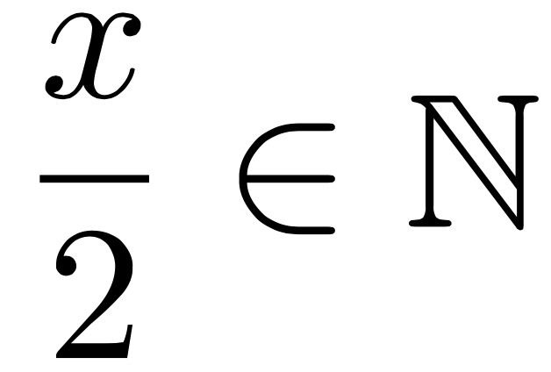
Example
We can write the set of all even numbers:

Slide 31
Example
We can write the set of real numbers whose square is less than 10:

Slide 32
Group Work:
Use set builder notation to write the following sets:
The set of real numbers bigger than 10 and less than 42
The set of prime natural numbers
The set of of all real numbers whose cube is bigger than or equal to 27
The set of rational numbers whose denominator is 3

Slide 33
The Union:
Definition: The Union of two sets A, B is
Recall this means “OR”
So it’s all the stuff in A or B…. so if it’s in A it’s in the union, also if it’s in B it must be in the union..

Slide 35
Let’s write the sets?
First, Andy’s set:

Slide 36
Let’s write the sets?
Now, Bob’s set:

Slide 37
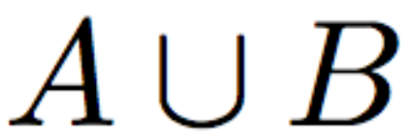
Let’s see it:

Slide 38
The intersection:
Definition: The intersection of two sets, is the set of elements that they share...

Slide 39
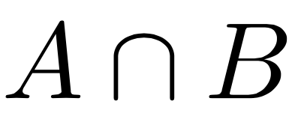
Let’s see it:

Slide 40
Group Work:
(HP)
(GR)
(RC)
(SL)

Slide 41
Complements (everything not in!)
Definition: The complement of a set is the set of everything that’s in the universe but not the original set

Slide 42
Example

Slide 43
Group Work:
7
Given the universe above, find the complement of the following sets:
7

Slide 44
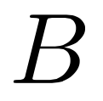
Venn Diagrams

Slide 45
Venn Diagrams (Bob and Andy)

Slide 46
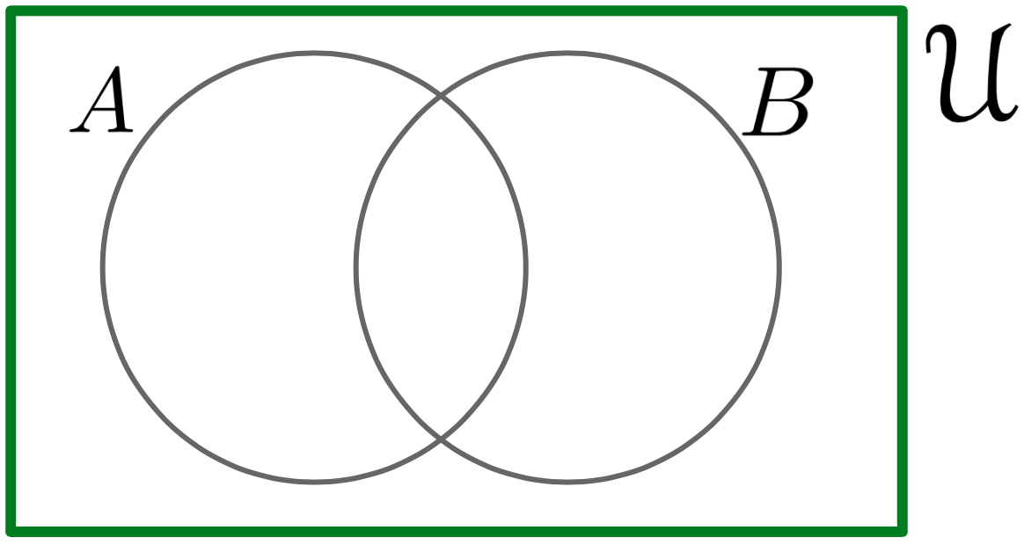
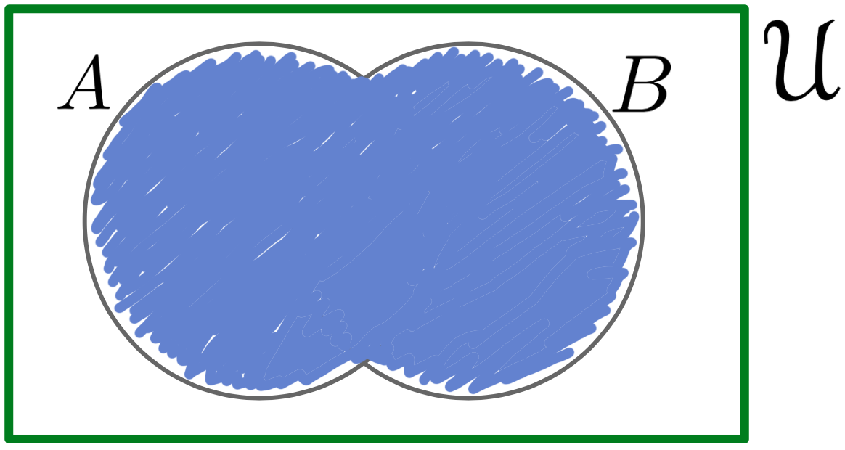
Venn Diagrams (Union)

Slide 47
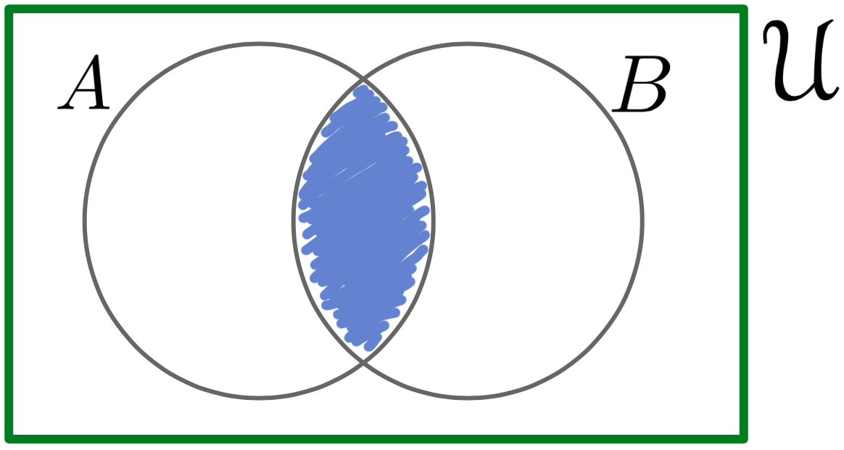
Venn Diagrams (Intersection)

Slide 48
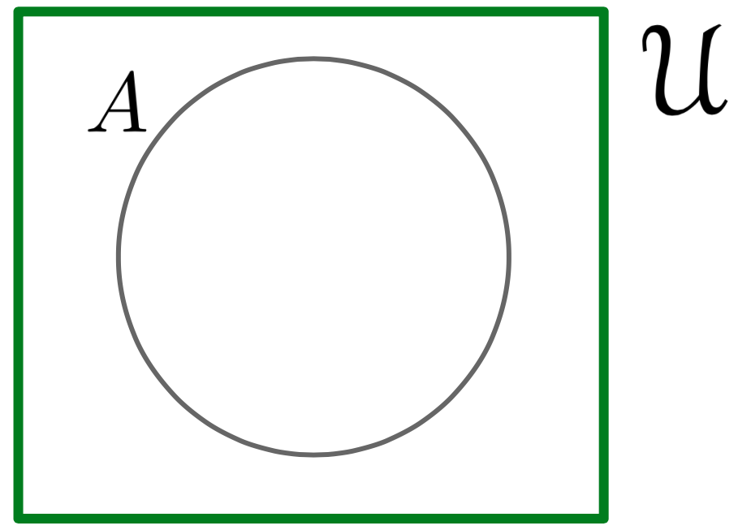
Venn Diagrams (Complement)

Slide 49
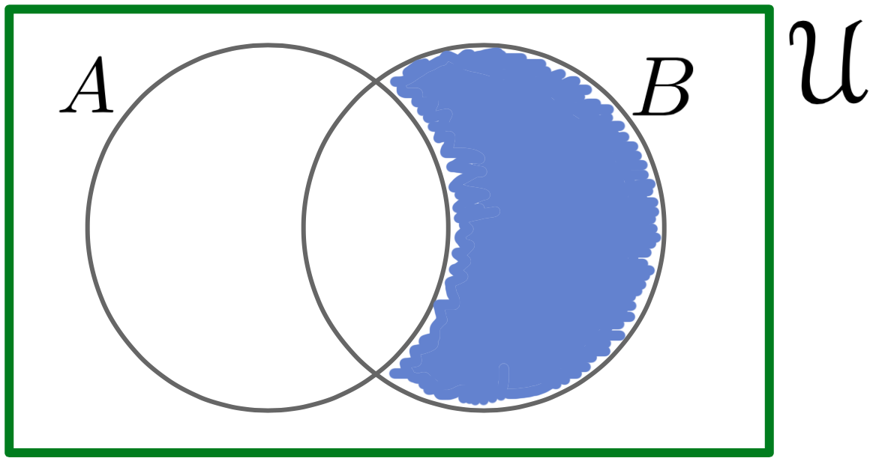
Venn Diagrams (All Together)

Slide 50
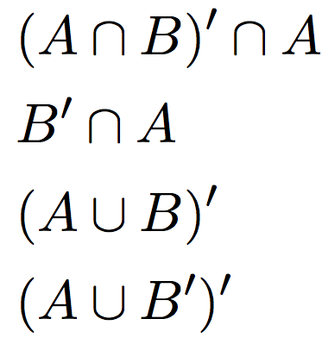
Group Work:
Shade in the indicated sets in a Venn Diagram for the following:

